Slide 1
ALGORITHM DESIGN
AND ANALYSIS
PROJECT 3: Dynamic Programming - Knapsack
Wong Chu Feng & Rivaldo Billy Sebastian

Slide 2
(1) Recursive Definition
Let P(C, n) a knapsack problem of capacity weight C and n types of objects. There are 2 possibilities.
If n-th type of object is included
If n-th type of object is not included

Slide 3
(1) Recursive Definition
If n-th type of object is included
Taking one of them takes w_{n} amount of space and contributes p_{n} amount of profit.
Knapsack problem of capacity weight C-w_{n} and n types of objects, which the maximum profit of P(C-w_{n}, n).
This case has solution of p_{n} + P(C-w_{n}, n).
If n-th type of object is not included
The knapsack problem only considers n-1 types of objects.
This case have solution of P(C, n-1).

Slide 4
(1) Recursive Definition
We want to take the maximum profit. Hence,
P(C, n) = max(p_{n} + P(C-w_{n}, n), P(C, n-1)).

Slide 5
(2) Subproblem Graph
P(0, 1)
P(0, 2)
P(2, 0)
P(2, 1)
P(2, 2)
Knapsack problem of capacity weight 14 and 3 types of objects as follows:
P(4, 0)
P(4, 1)
P(6, 0)
P(6, 1)
P(6, 2)
P(6, 3)
i | 0 | 1 | 2
w_{i} | 4 | 6 | 8
p_{i} | 7 | 6 | 9
P(8, 0)
P(8, 1)
P(8, 2)
P(10, 0)
P(10, 1)
have a subproblem graph:
P(14, 0)
P(14, 1)
P(14, 2)
P(14, 3)

Slide 6
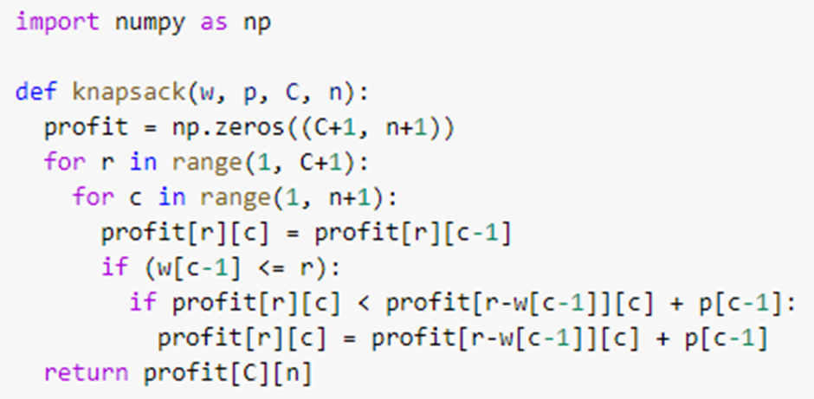
(3) Bottom-Up Approach

Slide 7
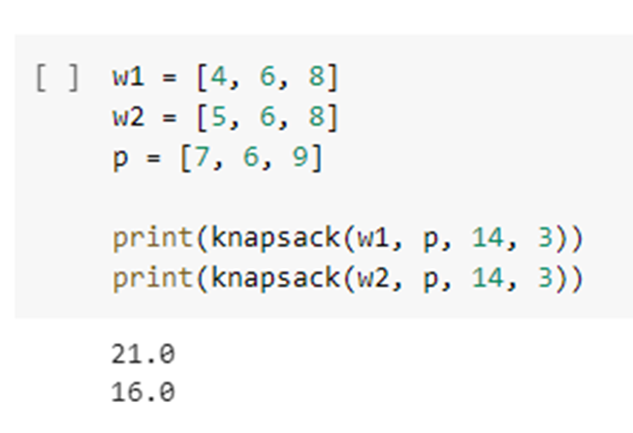
(1) Result of P(14)
With weights and profits given:
(a)
(b)
i | 0 | 1 | 2
w_{i} | 4 | 6 | 8
p_{i} | 7 | 6 | 9
i | 0 | 1 | 2
w_{i} | 5 | 6 | 8
p_{i} | 7 | 6 | 9

Slide 8
Thank You!

